Slide 1
Employee Data Analysis using Excel
STUDENT NAME: DHARSHINI.J
REGISTER NO:122203875/asunm1621122203875
DEPARTMENT: BCOM CS SHIFT 2
COLLEGE: SHASUN JAIN COLLEGE FOR WOMEN

Slide 2
PROJECT TITLE
Employee Performance Analysis using Excel

Slide 3


AGENDA
Problem Statement
Project Overview
End Users
Our Solution and Proposition
Dataset Description
Modelling Approach
Results and Discussion
Conclusion
3/21/2024 Annual Review

Slide 4

PROBLEM STATEMENT
Regular performance evaluations are vital for recognizing employee strengths, addressing areas for improvement, and driving success. They keep individuals focused on organizational priorities and encourage constant development. Neglecting this process can lead to disengagement and hinder performance growth.

Slide 5

PROJECT OVERVIEW
This project seeks to uncover the relationship between department type and employee performance by examining a comprehensive dataset. By categorizing employees by department, we will investigate trends and correlations between departmental characteristics, performance metrics, and employee ratings. Our analysis will reveal critical factors influencing performance ratings within each department, enabling data-driven decisions to refine departmental strategies, elevate talent development, and boost organizational effectiveness.

Slide 6

WHO ARE THE END USERS?
HR Managers: To create personalized development plans, tailored training programs, and informed talent management strategies.
-Department Leaders: To address performance gaps, recognize high achievers, and optimize departmental performance.
Executive Leadership: To align employee performance with business objectives, drive productivity, and foster engagement.
- Performance Review Committees: To ensure fair, data-driven evaluations and effective performance improvement initiatives.
- Business Analysts and Data Scientists: To uncover actionable insights, driving predictive analytics and strategic workforce planning

Slide 7

OUR SOLUTION AND ITS VALUE PROPOSITION
Unlock the full potential of your workforce with our data analytics solution, designed to uncover hidden insights into employee performance by department. Our methodology includes:-
--Advanced data filtering and classification
Conditional formatting for data integrity
- Pivot tables for efficient data summarization
- Multi-bar graphs for visual performance benchmarking
By applying these techniques, we reveal actionable patterns and trends, enabling data-driven decisions.:-
-Drive targeted performance enhancements
Elevate talent management strategies
- Optimize resource allocation for maximum ROI
- Foster strategic growth through data-informed planning

Slide 8
Dataset Description
The employee dataset, sourced from Kaggle, comprises the following key attributes:-
--Employee ID (Unique Identifier)
Full Name (Employee's complete name)
- Gender (Male, Female, Non-binary, etc.)
- Department Type (Sales, Marketing, Engineering, etc.)
- Performance Score (Textual rating: Excellent, Good, Average, Poor)
- Employee Rating (Numerical or categorical performance rating)
This comprehensive dataset enables a detailed analysis of employee performance, allowing for insights into departmental dynamics, gender disparities, and performance trends.

Slide 9

THE "WOW" IN OUR SOLUTION
Dynamic Pivot Table Analysis
Advanced Multi-bar chart
Visualisation Tailored Performance
Insights Interactive
Data Exploration Actionable
Recommendation
3/21/2024 Annual Review
9

Slide 10
MODELLING
Employee Performance Analysis
Data Collection- Source: Kaggle dataset- Attributes: Employee ID, Full Name, Gender, Department Type, Performance Score, Employee Rating
Data Cleaning- Handled missing values through imputation or removal
Features Considered- Employee ID (unique identifier)- Gender (categorical data)- Department Type (key feature for classification)- Performance Score (ordinal data, standardized to numeric scale)- Employee Rating (additional performance metric)
Techniques Used- Pivot Tables (summarize and classify performance data by Department Type)- Multi-Bar Charts (visualize and compare performance ratings across departments)
Visualizations- Pivot Table Views (summary tables and cross-tabulations)- Multi-Bar Charts (visual representations of performance ratings across departments).
10

Slide 11
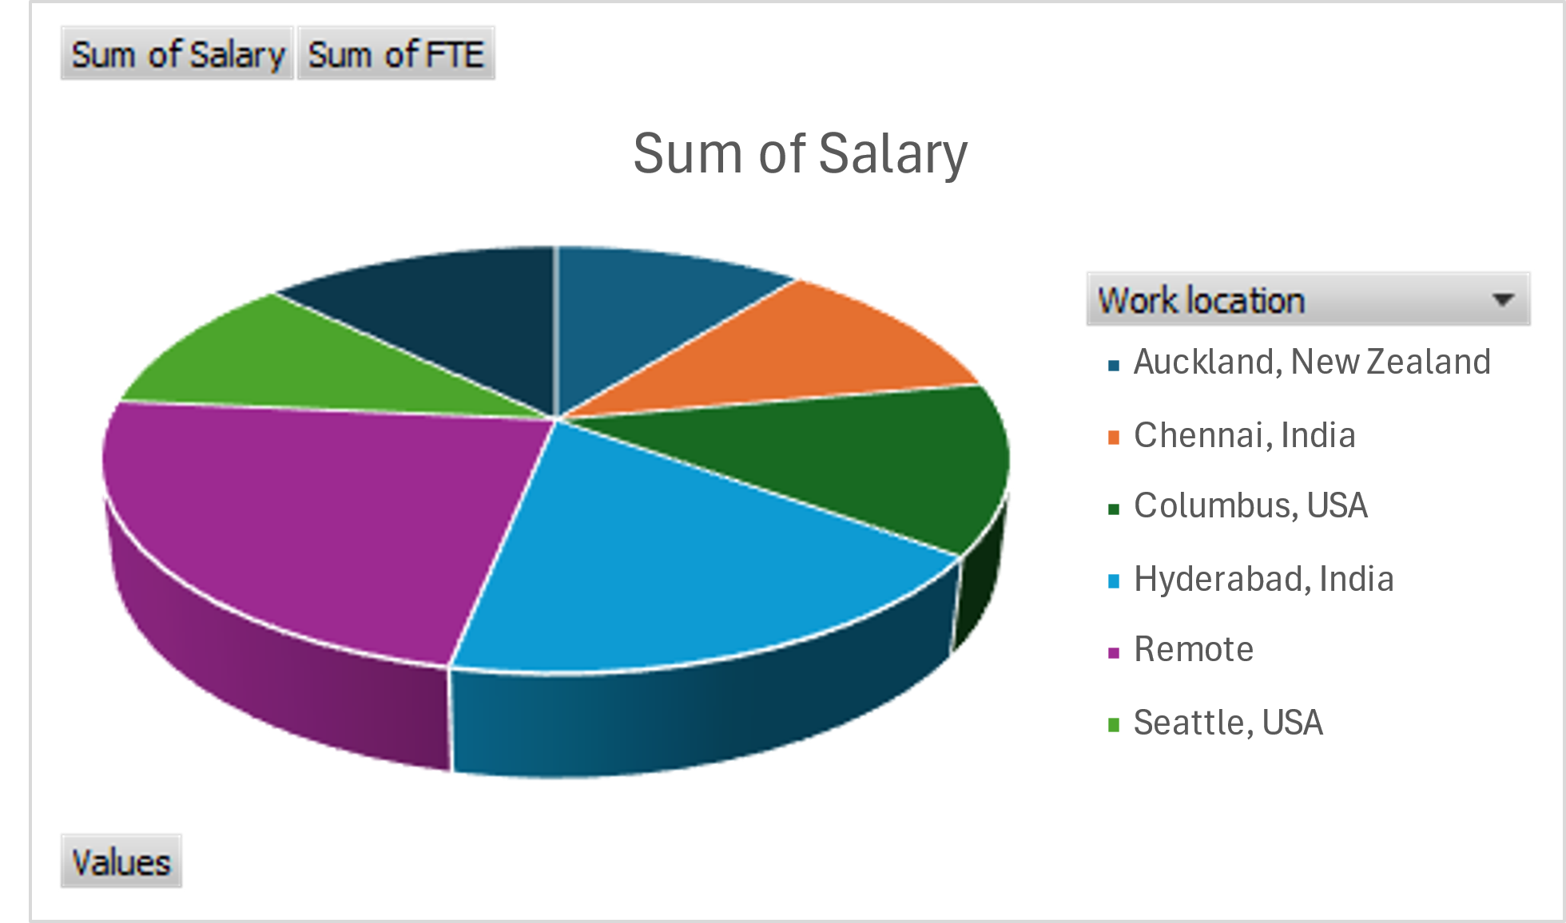
RESULTS
11

Slide 12
conclusion
The employee performance analysis project uncovered valuable insights into departmental performance variations. By leveraging data cleaning, pivot tables, and multi-bar charts, we classified, summarized, and visualized performance data, revealing key trends and patterns. Our findings enable data-driven decisions for HR, department heads, and executives to enhance employee development, optimize strategies, and drive organizational success. By addressing performance gaps and leveraging strengths, the organization can foster a more effective and motivated workforce, driving long-term growth and competitive advantage

